Slide 1
HDAR Prototype
Query Report Content

Slide 2
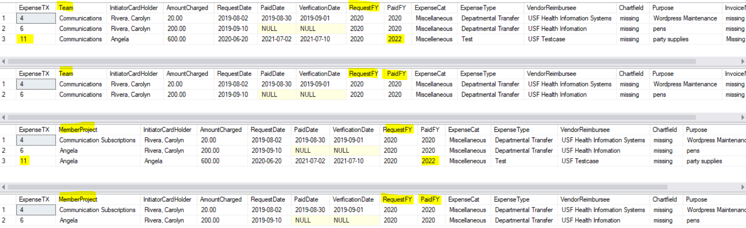
Expense Lines by Team or Member with Filter by RequestFY and PaidFY

Slide 3
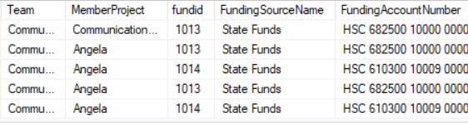
Select * each expense from ExpenseActual Table, Join with Individual Funding Account Paid for each expense
Notice each row is an expense split between all of the funds sharing in that expense
Includes Team, Member,
Fund Type, Account Number
Includes vendor and purpose

Slide 4
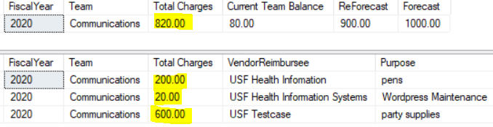
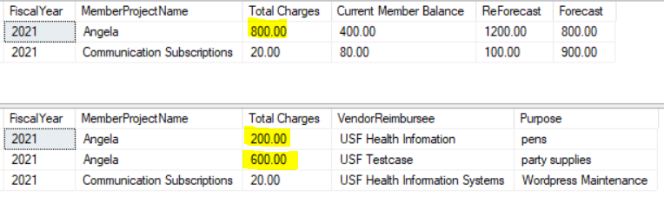
Team Spend, Member Spend Aggregate (roll up) and drill down by VenderReimbursee and Purpose

Slide 5
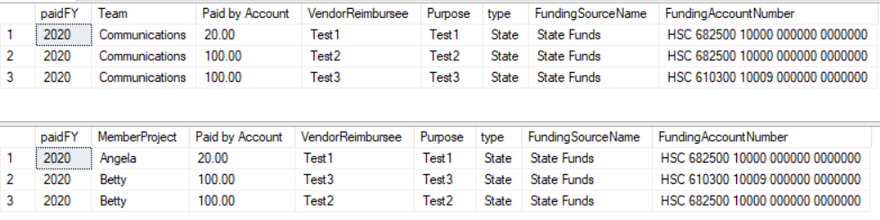
Team versus Member Individual Line Expense
Paid Out by Each Individual Fund Account Number
with vendorReimburse and purpose

Slide 6
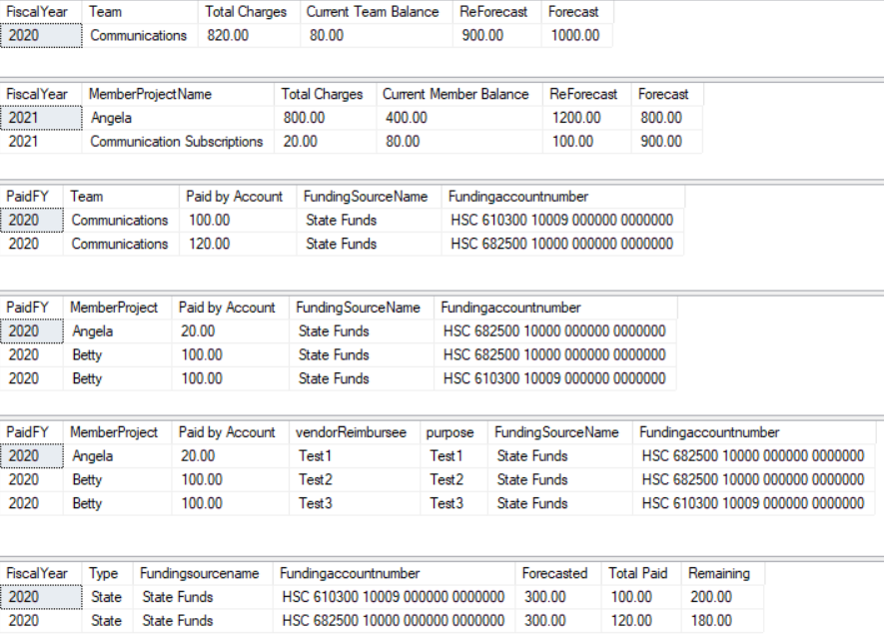
Team Total Spend
Member Total Spend
Team Total Paid by Individual Funding Account Number
Member/Project Total Expenses and which Individual Funding Account Number Paid
Member/Project Total Expenses and which Individual Funding Account Number Paid with vendor and purpose
Individual Funding Account Number Projection, Total Paid, and Remaining

Slide 7
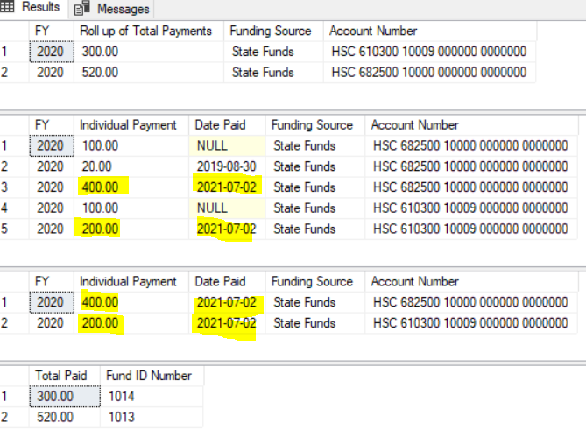
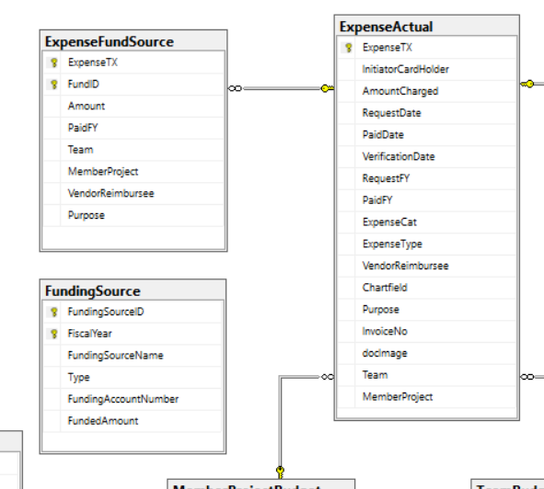
Payments made by Individual Funding Accounts
Roll up of all Payments made by an Individual Funding Account for a Fiscal Year
Individual Payments by Individual Funding Account and Date Paid
Individual Payments by Individual Funding Account filtered by month of Paid date
System Logic Check of Query

Slide 8
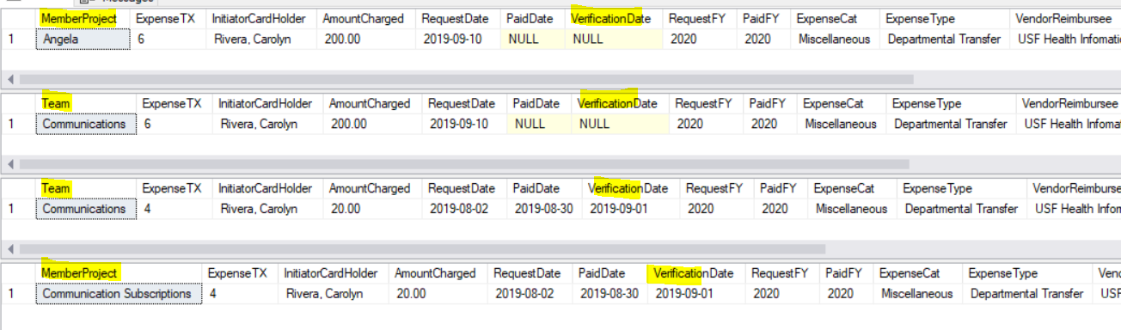
Return all expenses by request month verified versus not verified for team and for member

